Slide 1


LOGISTIC REGRESSION

Slide 2
INTRODUCTION
Logistic regression is a supervised machine learning algorithm used for classification tasks where the goal is to predict the probability that an instance belongs to a given class or not. Logistic regression is a statistical algorithm which analyze the relationship between two data factors.
Few examples of binary classification problems which can be solved using logistic regression-
The probability of a political candidate winning or losing the next election.
Whether a machine in manufacturing will stop running in a few days or not.
Filtering email as spam or not spam.

Slide 3
LOGISTIC/ SIGMOID FUNCTION
y = mx + c
The Sigmoid Function is a machine learning activation function that is used to introduce non-linearity to a machine learning model.
The sigmoid function, commonly known as the logistic function, predicts the likelihood of a binary outcome occurring. The function takes any value and converts it to a number between 0 and 1.
In Logistic Regression python, iterative optimization algorithms like Gradient Descent or probabilistic methods like Maximum Likelihood are used to get the “best fit” S curve.

Slide 4
TYPES OF LOGISTIC REGRESSION
01
Binomial Regression:
In binomial Logistic regression, there can be only two possible types of the dependent variables, such as 0 or 1, Pass or Fail, etc.
02
Multinomial Regression:
In multinomial Logistic regression, there can be 3 or more possible unordered types of the dependent variable, such as “cat”, “dogs”, or “sheep”.
03
Ordinal Regression:
In ordinal Logistic regression, there can be 3 or more possible ordered types of dependent variables, such as “low”, “Medium”, or “High”.

Slide 5




APPLICATIONS OF LOGISTIC REGRESSION
Medicine
Gaming
Hotel
Finance
Notes:
1. Medicine: It’s used to predict the probability of a patient having a certain disease based on their medical history and demographics.
2. Gaming: To predict player retention or in-game purchases.
3. Hotel Booking: Predicting the likelihood of a booking cancellation.
4. Credit Scoring: Financial companies use logistic regression for predictive models to determine creditworthiness.

Slide 6
CHALLENGES & LIMITATIONS
01
Outliers :
Sensitive to outliers which can disproportionately influence the outcome.
02
Multicollinearity :
High correlation among independent variables can affect the model’s estimates.
03
Linearity :
It assumes a linear relationship between the independent variables and the log odds of the dependent variable.
04
Independence :
Observations are assumed to be independent of each other, which may not be true in some cases.
05
Overfitting :
Without proper selection of variables, it can overfit to the training data.

Slide 7
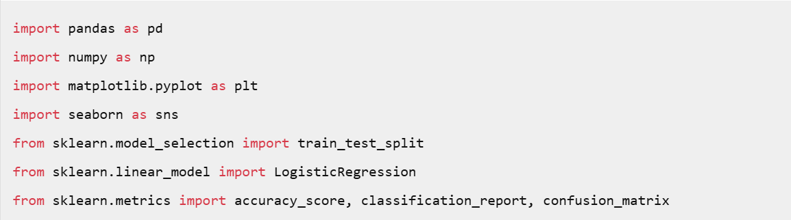
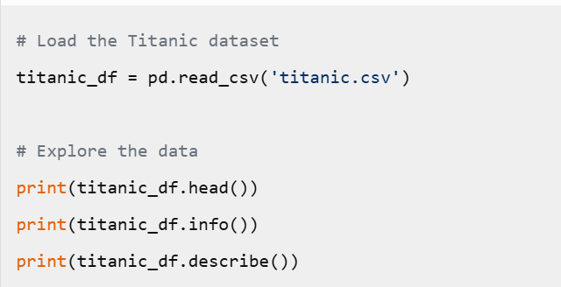
CODE
IMPORTS
2. LOAD and EXPLORE THE DATA

Slide 8
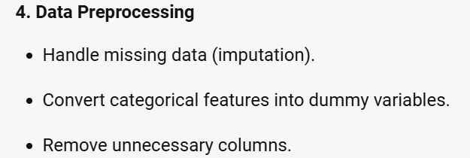
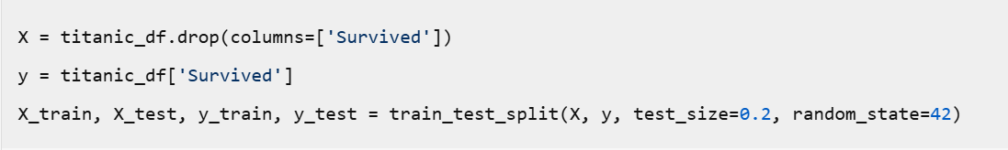
CODE
5. SPLIT DATA into TRAIN and TEST SETS

Slide 9
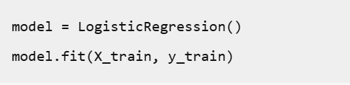

CODE
6. BUILD and TRAIN the LOGISTIC REGRESSION
7. MAKE PREDICTIONS

Slide 10
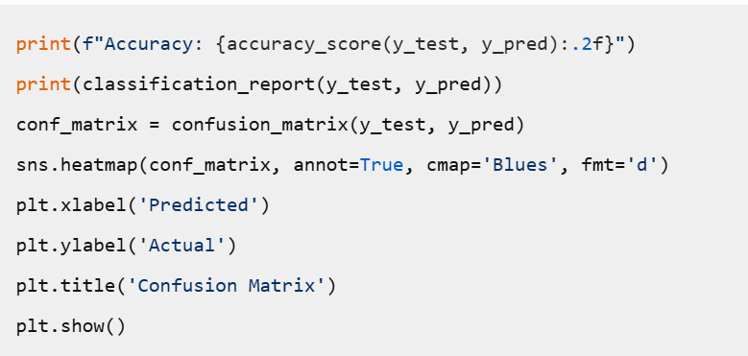
CODE
8. EVALUATE MODEL PERFORMANCE

Slide 11
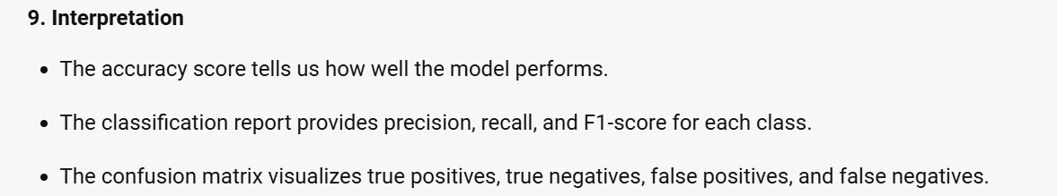
CODE

Slide 12
CONCLUSION
Logistic regression is a statistical method used for binary classification that can extend to multiclass classification via techniques like one-vs-rest (OvR) or multinomial logistic regression. It utilizes the sigmoid function to model the probability of a binary outcome, offering a probability score between 0 and 1. Logistic regression models are widely applied in fields such as medicine, finance, and social sciences for risk assessment, odds prediction, and more.
The main challenges and limitations of logistic regression include its assumption of linearity between the dependent variable and the independent variables, difficulty in handling non-linear relationships without transformation or adding interaction terms, and its reliance on large sample sizes for stable results. Despite these challenges, logistic regression remains a popular choice due to its simplicity, interpretability, and efficiency in cases where its assumptions hold true.

Slide 13
THANK YOU
BY - NAVYA SHAH

